Slide 1
My name is Ioanna Nikolaou
Operational forecaster at Hellenic National Meteorological Service(HNMS).
Education and training
BSc in Mathematics from National Kapodistrian University of Athens,
MSc in Physics meteorology and environment from National Kapodistrian University of Athens
Diploma in Meteorology from military meteorological school of Ministry of defence(certified by W.M.O)
Main activities and responsibilities
Operational forecaster issuing marine bulletins and gale warnings
Issuing aeronautical bulletins for the airports
Weather forecasting for the public

Slide 2
Cold intrusion 28-30 December 2016 in Greece from the north causing severe wheather : snowfall and gale-storm winds
Ιoanna Nikolaou

Slide 3
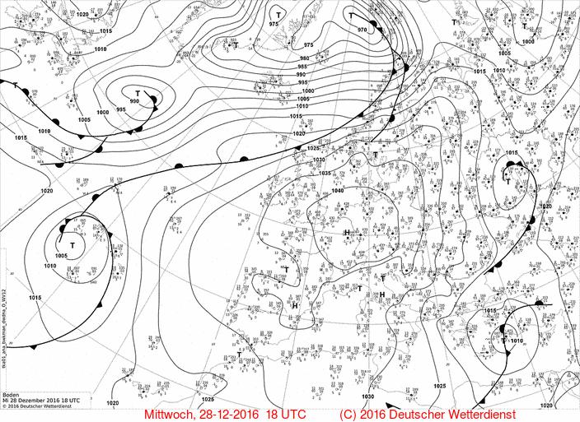
msl analysis 28-12-2016 18UTC

Slide 4
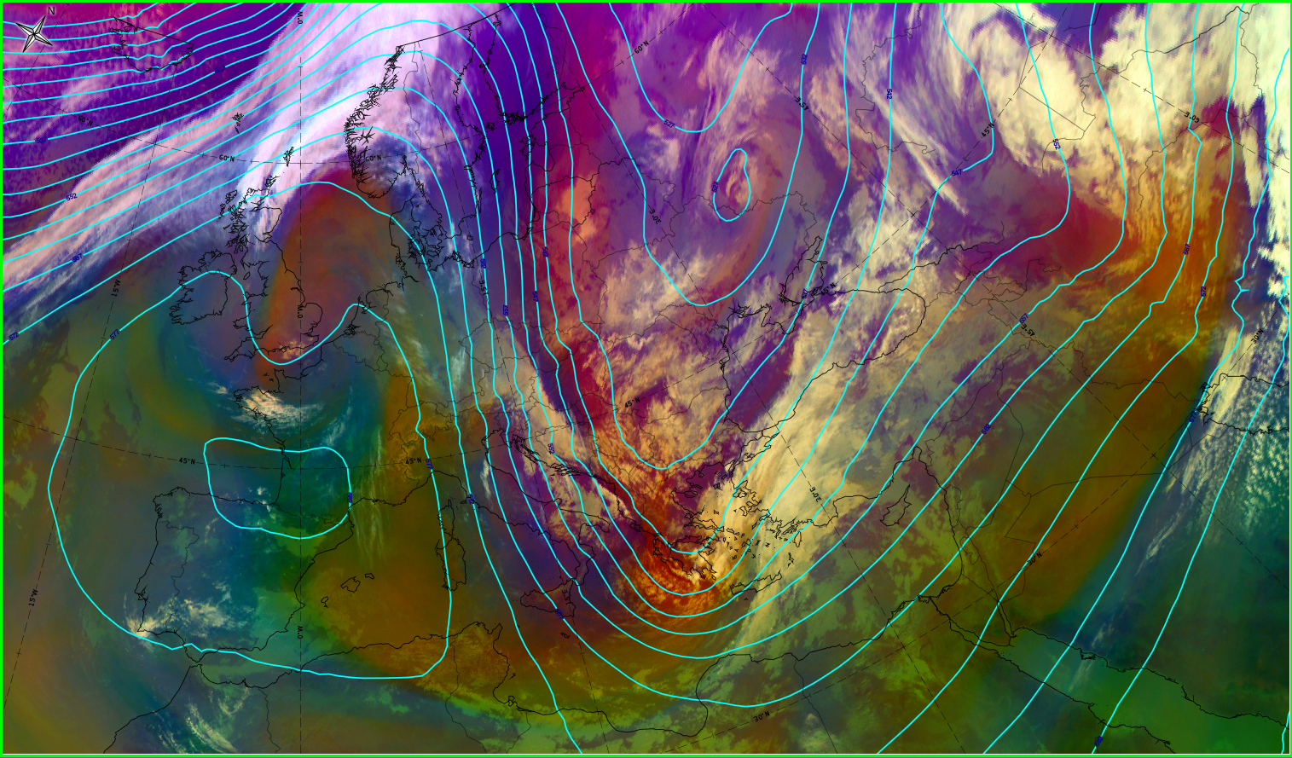
RGB

Slide 5
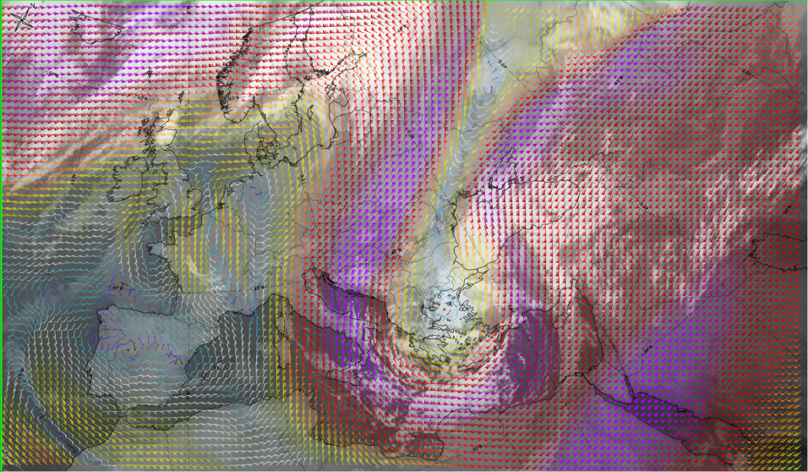
winds 300hpa-IR 10.8 29-12-2016 06 UTC
Εικόνα 1: winds 300hpa-IR 10.8 28-12-2016 12UTC

Slide 6
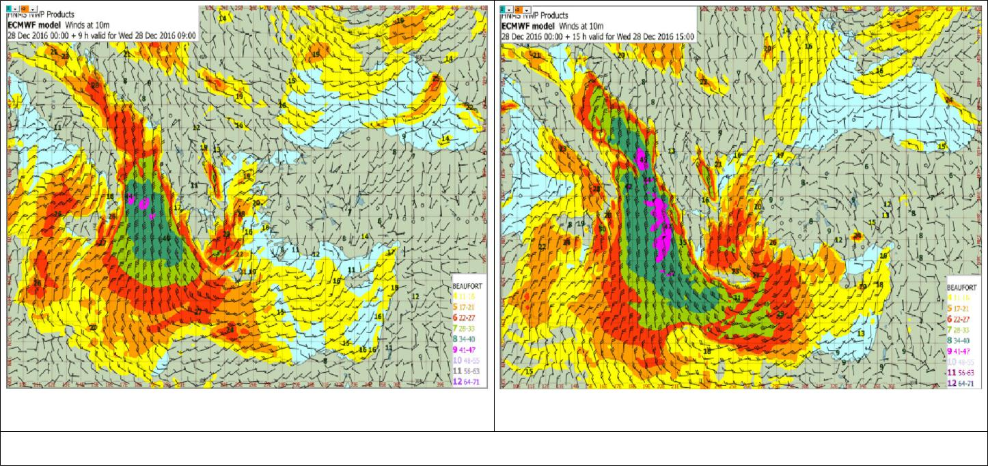
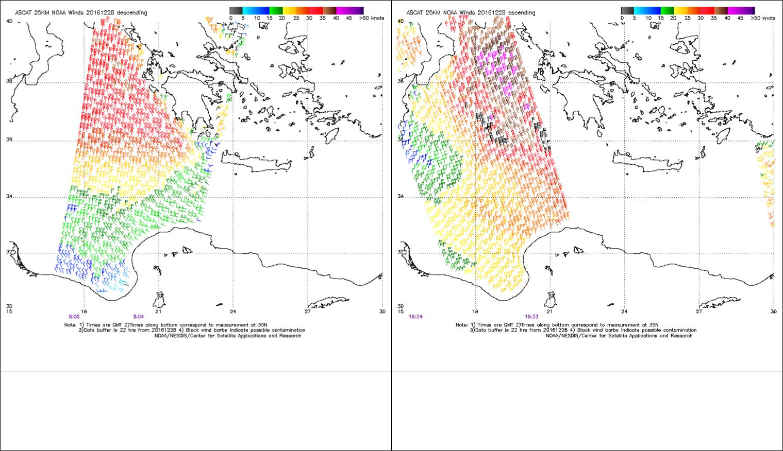
ASCAT WINDS 28-12-2016 08.05 UTC
ASCAT WINDS 28-12-2016 19.23 UTC

Slide 7
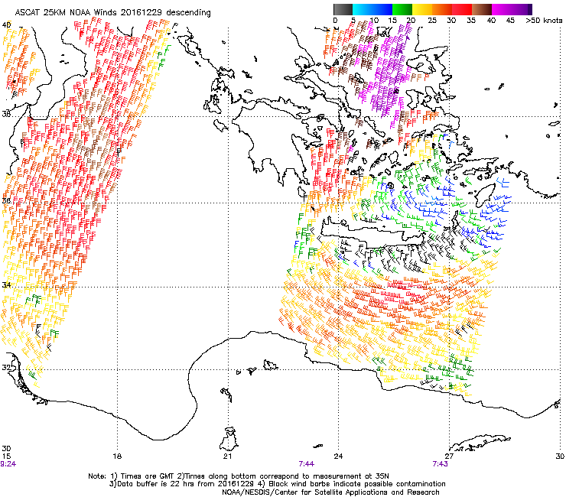
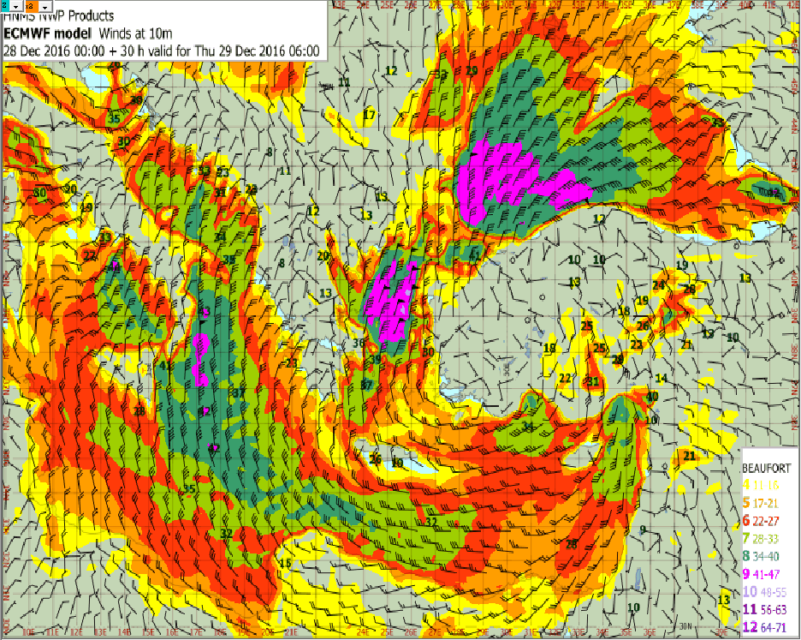
ASCAT WINDS 29-12-2016 07.44 UTC

Slide 8
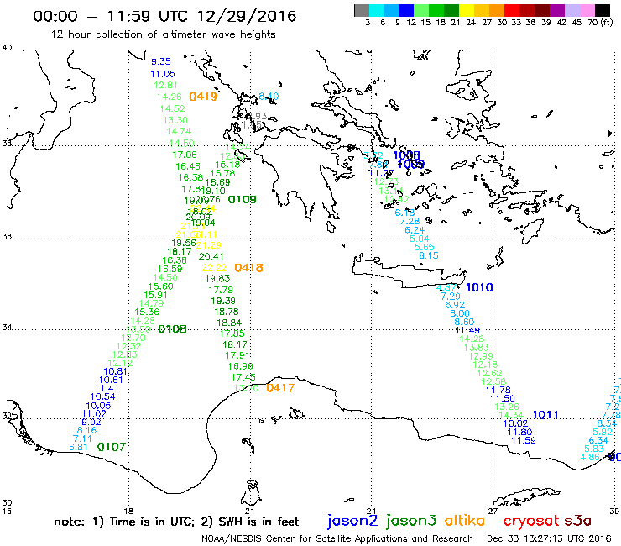

Slide 9
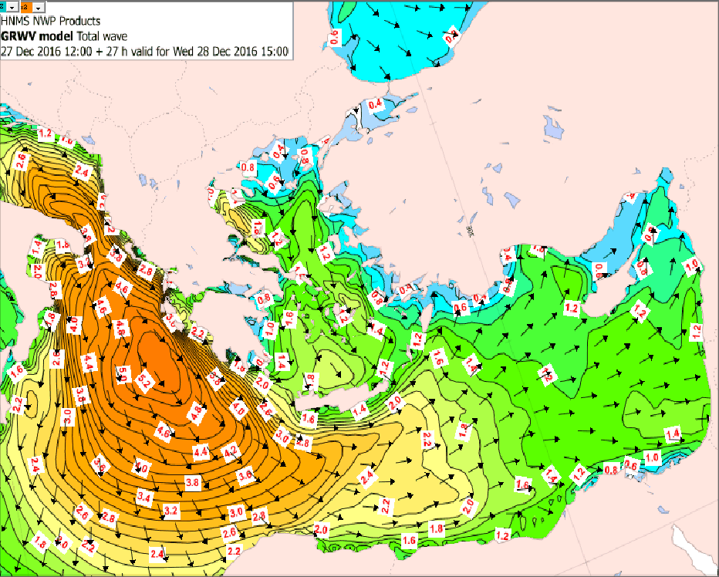
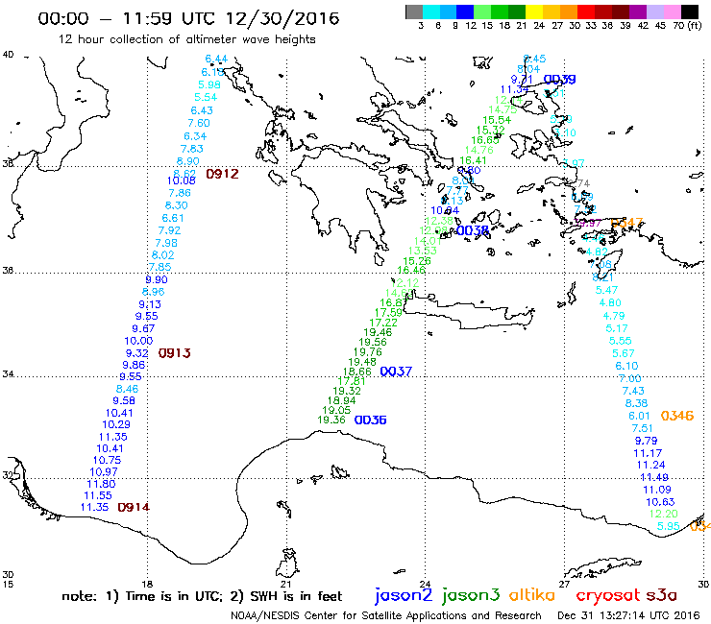

Slide 11
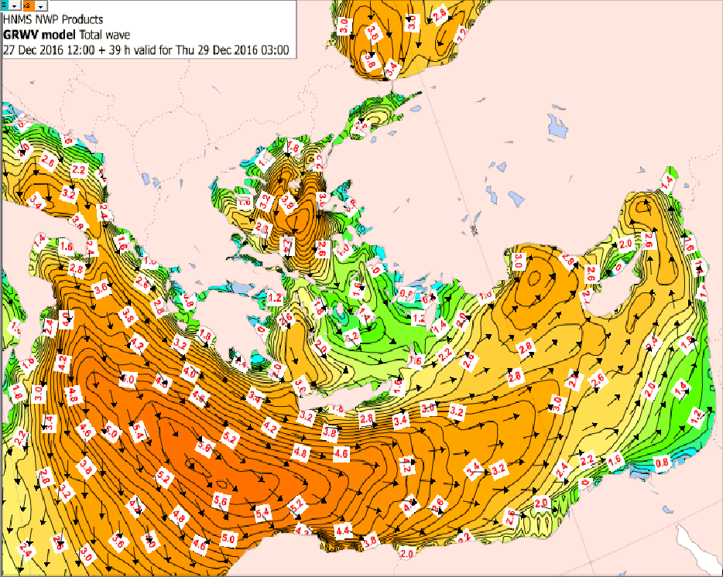
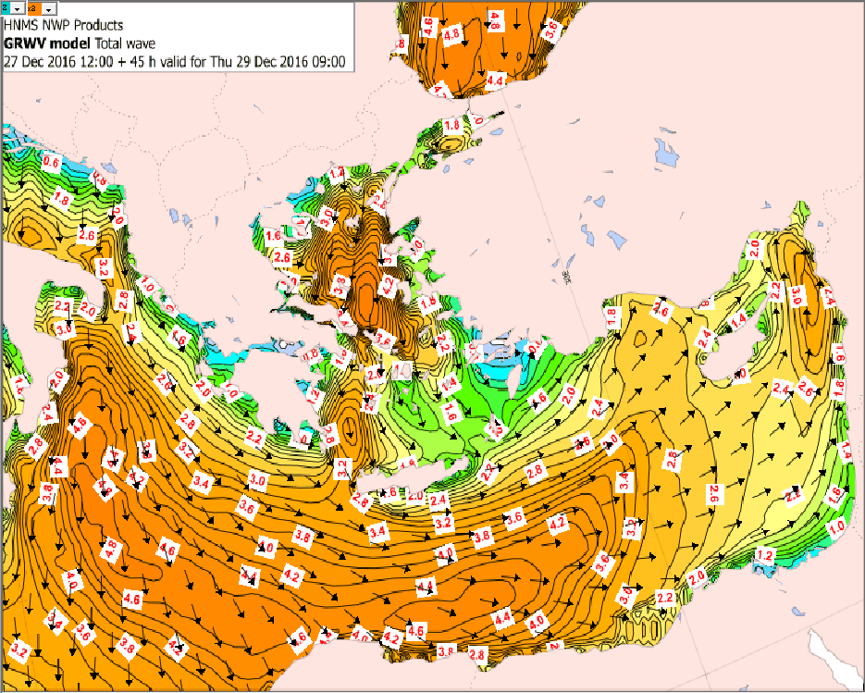

Slide 12
