Slide 1
CARDIAC ELECTROPHYSIOLOGY ANATOMY AND PHYSIOLOGY

Slide 2
Disclaimer
This course is provided for general educational purposes only and should not be considered the exclusive source for this type of information. This training does not replace or supersede approved labeling. The content will be shared with physicians and allied health professionals who seek a deeper understanding of the operation and use of Medtronic products and therapies with the intent of enhancing their knowledge of features and operations described in the clinician manuals.

Slide 3
INTRODUCTION
01
Cardiac anatomical structures
02
Cardiac electrical conduction
03
Electrical conduction and the ECG
SUMMARY

Slide 4
INTRODUCTION
In this module, you will learn about the anatomical structures of the heart and their functions. You will also find out about how electrical impulses travel through the heart, the mechanical effect of this and why the heart contracts.
After completing this module you will be able to:
Identify the names, locations and functions of the main cardiac anatomical structures
Explain how an electrical impulse travels through the heart, and explain what happens mechanically as the electrical impulse moves
Explain what causes the heart to contract by describing automaticity, the action potential cycle of a cardiac cell, the role of the sinus node, and the heart’s natural back-up mechanisms

Slide 5
INTRODUCTION
01
Cardiac anatomical structures
02
Cardiac electrical conduction
03
Electrical conduction and the ECG
SUMMARY

Slide 6
CARDIAC ANATOMICAL STRUCTURES
1

Slide 7
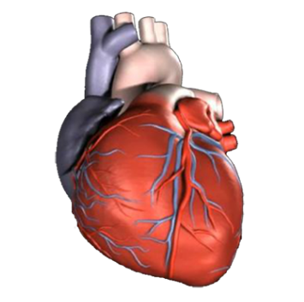
1
THE HEART
The heart is:
A four chambered, muscular organ
Responsible for the vital transport of blood, oxygen, nutrients, and byproducts to and from the tissues
In an infant and child, the heart is about the same size as their fist. However, the average adult heart is about the size of two fists.
Average female heart is 0.250 kg
Average male heart is 0.300 kg

Slide 8
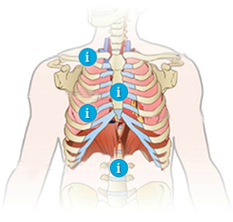
1
THORACIC CAVITY
The thoracic cavity contains the heart and lungs
Clavicle
The clavicle is used as an important landmark for physicians; many pacing leads are placed into the subclavian vein in what is know as the subclavian stick method.
Ribs
Part cartilaginous bones which together with the sternum protect the vital organs.
1
2
3
Sternum
Connects the ribs together to form a protective cage.
Vertebra
Cartilaginous bones which form the spinal column.
4

Slide 9
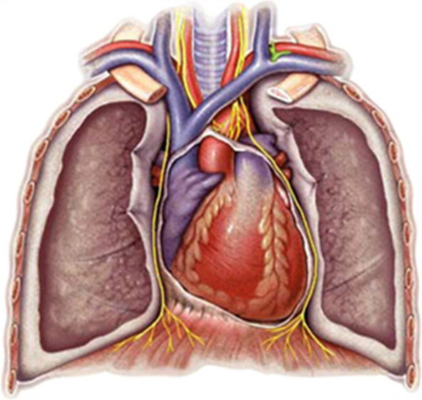
1
THORACIC CAVITY
DIAPHRAGM AND PHRENIC NERVE
The thoracic cavity contains the heart and lungs
Left phrenic nerve
The phrenic nerve is made up of motor nerve fibers that produce contractions of the diaphragm, and sensory innervation for the mediastinum, pericardium, pleura, diaphragm, upper abdomen, liver, and gall bladder.
The left phrenic nerve passes over the left ventricle and innervates, or passes through the diaphragm.
Right phrenic nerve
The phrenic nerve runs laterally to the heart. The right phrenic nerve passes over the subclavian vein before it passes over the right atrium and down through the diaphragm.
2
1
Diaphragm
The diaphragm encloses the thoracic cavity and separates it from the abdominal cavity. It is the primary muscle used during breathing. During inhalation the diaphragm contracts, causing the thoracic cavity to expand.
3

Slide 10
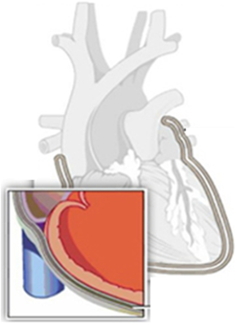
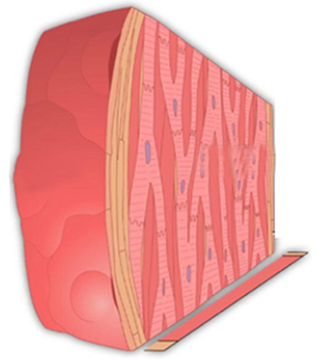
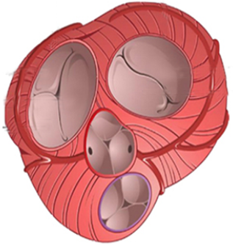
1
OTHER STRUCTURES OF THE HEART
Below are some other anatomical structures of the heart.
Click on the images to learn more
The pericardium is a thin, membranous, fibroserous sac that surrounds and protects the heart.
The wall of the heart has three distinct layers of tissue: the epicardium, the myocardium and the endocardium.
Heart valves open and close in response to pressure changes as the heart contracts and relaxes. This action ensures the unidirectional flow of blood.

Slide 11
1
OTHER STRUCTURES OF THE HEART
PERICARDIUM
Pericardial cavity
The pericardial cavity is located between the pericardium and outermost layer of the heart, called the epicardium.
It contains a small amount of pericardial fluid that acts as a lubricant to allow the heart to fill and empty in a frictionless environment.
2
1
Pericardial sac
The pericardial sac confines and stabilizes the position of the heart in the thoracic cavity.

Slide 12
1
OTHER STRUCTURES OF THE HEART
WALLS OF THE HEART
Epicardium
Thin, fibrous external surface where the coronary arteries lie.
3
Myocardium
Thick, middle layer with involuntary cardiac muscle cells that contract to propel blood.
1
2
Endocardium
Innermost layer, forms the smooth lining heart’s chambers and also helps form the heart’s valves.

Slide 13
1
OTHER STRUCTURES OF THE HEART
VALVES OF THE HEART
1
2
1
2
Atrioventricular Valves
Semilunar Valves
There are two atrioventricular valves in the heart: the mitral valve, and the tricuspid valve.
Tricuspid valve is located between the right atrium and the right ventricle.
Mitral valve is located between the left atrium and the left ventricle.
There are two semilunar valves in the heart.
Aortic valve is located between the left ventricle and the aorta.
Pulmonary valve is located between the right ventricle and the pulmonary artery.

Slide 14
Which nerve is made up of motor nerve fibers that produce contractions of the diaphragm?
Brachial Nerve
Thoracic Nerve
Pectoral Nerve
Phrenic Nerve

Slide 15
Which nerve is made up of motor nerve fibers that produce contractions of the diaphragm?
Brachial Nerve
Thoracic Nerve
Pectoral Nerve
Phrenic Nerve

Slide 16
The pericardium is a thin membranous, fibroserous sac that surrounds and protects the heart.
True
False

Slide 17
The pericardium is a thin membranous, fibroserous sac that surrounds and protects the heart.
True
False

Slide 18
The wall of the heart has three distinct layers of tissue.
Epicardium, pericardium, myocardium
Endocardium, pericardium, myocardium
Epicardium, myocardium, endocardium
None of the above

Slide 19
The wall of the heart has three distinct layers of tissue.
Epicardium, pericardium, myocardium
Endocardium, pericardium, myocardium
Epicardium, myocardium, endocardium
None of the above

Slide 20
The aortic valve is located between the left ventricle and the aorta.
True
False

Slide 21
The aortic valve is located between the left ventricle and the aorta.
True
False

Slide 22
INTRODUCTION
01
Cardiac anatomical structures
02
Cardiac electrical conduction
03
Electrical conduction and the ECG
SUMMARY

Slide 23
CARDIAC ELECTRICAL CONDUCTION
2

Slide 24
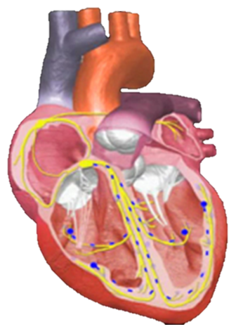
2
NORMAL HEART CONDUCTION
Electrical activation always precedes mechanical activation, just by milliseconds.
Heartbeats occur as electrical impulses move through the heart.
The electrical side of the heart and its contractions are at the core of how the heart operates. This is what constitutes a heartbeat.

Slide 25
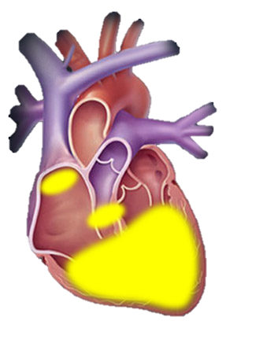
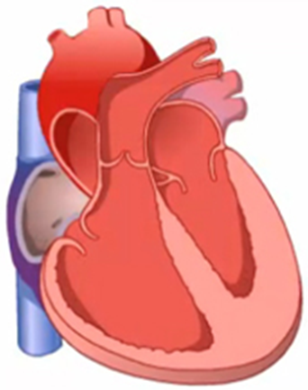
2
DEPOLARIZATION, REPOLARIZATION AND AUTOMATICITY
Depolarization and Repolarization
Automaticity
Depolarization occurs when electrically charged ions travel in and out of cardiac cells. Depolarization describes cardiac cells in a state of contraction
After the cardiac cell is stimulated and fully depolarized, it begins to return to its resting state. This process is called repolarization. Repolarization describes cardiac cells in a state of relaxation
Different areas of the normal heart have differing rates of automaticity. The fastest pacemaker cells will drive the heart rate.
All cardiac cells have automaticity
Automaticity is the ability of cardiac cells to contract or depolarize spontaneously without external influence

Slide 26
2
ACTION POTENTIAL OF THE HEART
Click the tabs to learn more
DEFINITION
5 PHASES
REFRACTORY PERIOD

Slide 27
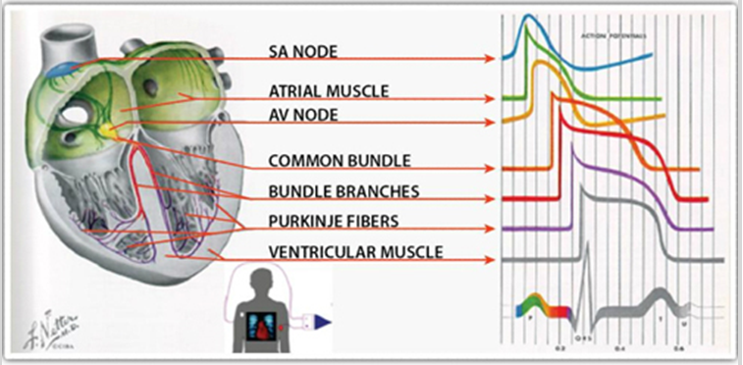
2
ACTION POTENTIAL OF THE HEART
Click the tabs to learn more
DEFINITION
Action potential is the term used to describe specifically how the energy within each cell is generated and used, ultimately causing the heart to contract.
5 PHASES
REFRACTORY PERIOD

Slide 28
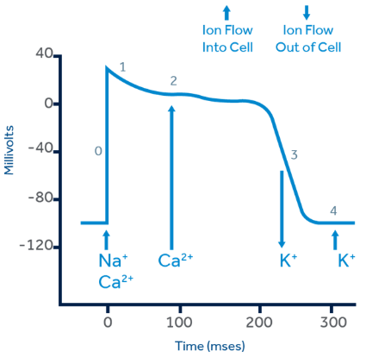
2
ACTION POTENTIAL OF THE HEART
Click the tabs to learn more
DEFINITION
5 PHASES
Phase 0 Rapid or upstroke depolarization with an influx of sodium ions into the cell
Phase 1 Early rapid repolarization with transient onward movement of potassium ions
Phase 2 Plateau Phase: Continued influx of sodium and slow influx of calcium
Phase 3 Repolarization: Potassium outflow
Phase 4 Resting phase
REFRACTORY PERIOD

Slide 29
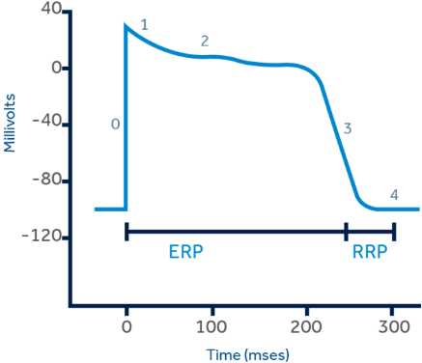
2
ACTION POTENTIAL OF THE HEART
Click the tabs to learn more
DEFINITION
5 PHASES
REFRACTORY PERIOD
ERP (Effective Refractory Period)
Absolute Refractory Period
Phases 0, 1, 2, and early Phase 3
A depolarization cannot be initiated by an impulse of any strength
RRP (Relative Refractory Period)
Late Phase 2 and early Phase 3
A strong impulse can cause depolarization, possibly with aberrancy
“R on T” phenomena

Slide 30
2
AUTOMATICITY: CARDIAC CELLS
Different areas of the heart have differing rates of automaticity. The cardiac cells that depolarize the fastest will drive the heart rate. In a normal heart, the SA node is the fastest, and so acts as the area of the heart that drives the pace. A normal resting heart rate range is between 60 to 100 beats per minute.
Click the icons to learn more
Sinus Node
Generally, 60 - 100 bpm.
Atrioventricular node
40 – 60 bpm.
Purkinje network
Generally, 20 – 40 bpm.
1
2
3

Slide 31
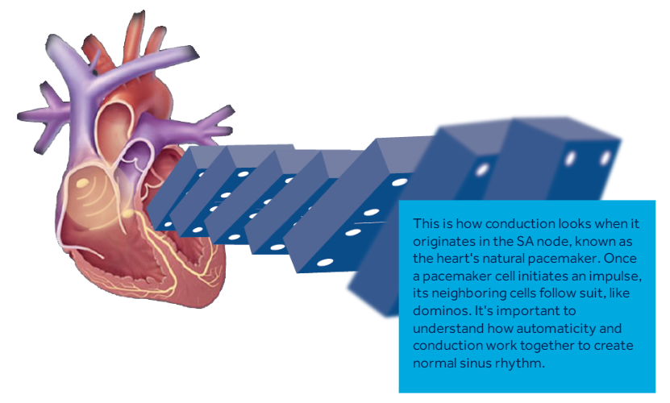
2
AUTOMATICITY: THE DOMINO EFFECT
This is how conduction looks when it originates in the SA node (also known as the heart’s natural pacemaker).
Once a pacemaker cell initiates an impulse, its neighboring cells follow suit, like domino’s. It’s important to understand how automaticity and conduction work together to create normal sinus rhythm.

Slide 32
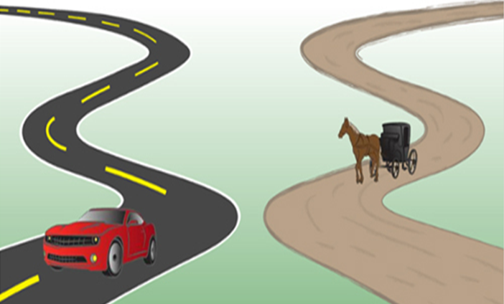
2
AUTOMATICITY AND CONDUCTION
Electrical impulses that use the normal conduction system result in rapid depolarization. This can be likened to a sports car speeding down a superhighway.
Electrical impulses that originate outside of the normal conduction system use the slow route: the cell-to-cell pathway. This can be likened to a horse and buggy moving on a dirt road.
Depolarization resulting in conduction travels down two different paths: one path is fast and the other path is slow.

Slide 33
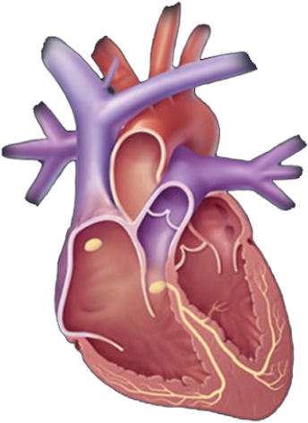
2
THE HEART’S CONDUCTION SYSTEM
The conduction system is a system of specialized cardiac tissue that controls the heart’s activity.
Specifically, this system controls the speed and rhythm of heart contractions using the two main properties you have been learning about:
Automaticity, the ability of conduction fibers to spontaneously depolarize
Conductivity, the ability of cardiac cells to rapidly conduct the electrical impulse
This electrical control system ensures that the heart keeps pumping, and it adjusts its pumping rate to meet the body’s needs during different activities, for example, sleeping, or intense physical effort.

Slide 34
2
THE HEART’S CONDUCTION SYSTEM
Click number 1 to begin
Sinus node (SA Node)
The conduction system in a normal heart begins with the sinus node. The SA node is located in the upper right atrium and is known as the heart’s natural pacemaker.
It produces resting rates between 60 to 100 beats per minute
Bundle of His
Just below the AV node, the impulse passes through the bundle of His, at the forefront of the His-Purkinje network.
Begins conduction to the ventricles
AV Junctional Tissue:
Rates between 40-60 bpm
1
Atrioventricular node (AV Node)
The atrioventricular, or AV node, is located between the atrium and the ventricles in the interatrial septum close to the tricuspid valve.
The AV node receives the impulse from the SA node delivers impulses to the His-Purkinje System at a rate between 40-60 bpm.
Purkinje Network
The bundle branches and the Purkinje fibers make up the Purkinje Network. (The other number 4s indicate the extent of the network.)
The network moves the impulses at rates between 20 to 40 beats per minute; this is known as an “escape” rhythm.
2
4
3
4
4
4
4

Slide 35
Action potential is the term used to describe specifically how the energy within each cell is generated and used, ultimately causing the heart to contract.
True
False

Slide 36
Action potential is the term used to describe specifically how the energy within each cell is generated and used, ultimately causing the heart to contract.
True
False

Slide 37
During this period, a cardiac cell can be stimulated to depolarize.
Automaticity Period
Relative Refractory Period (RRP)
Depolarization Period
Effective Refractory Period (ERP)

Slide 38
During this period, a cardiac cell can be stimulated to depolarize.
Automaticity Period
Relative Refractory Period (RRP)
Depolarization Period
Effective Refractory Period (ERP)

Slide 39
This group of cardiac cells is known as the heart’s natural pacemaker.
Purkinje network
AV node
SA node
His bundle

Slide 40
This group of cardiac cells is known as the heart’s natural pacemaker.
Purkinje network
AV node
SA node
His bundle

Slide 41
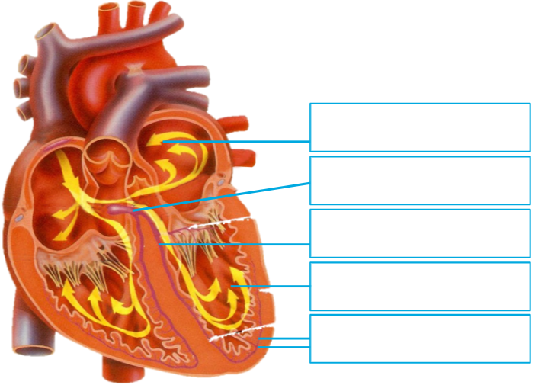
Label the heart diagram below, using the following key words.
DRAG AND DROP IMAGE AND LABELS
Drag the labels below to the correct location.
Left ventricle
Left Bundle Branch (LBB)
His bundle
Purkinje fibers
Left atrium

Slide 42
Label the heart diagram below, using the following key words.
DRAG AND DROP IMAGE AND LABELS
Drag the labels below to the correct location.
Left atrium
His bundle
Left Bundle Branch (LBB)
Left ventricle
Purkinje fibers

Slide 43
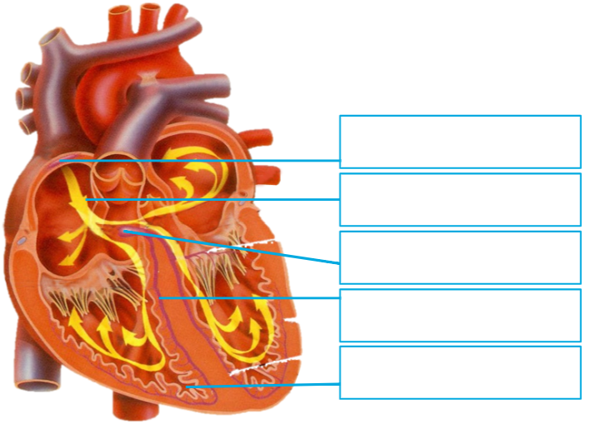
Label the heart diagram below, using the following key words.
DRAG AND DROP IMAGE AND LABELS
Drag the labels below to the correct location.
Atrioventricular node
Right Bundle Branch (RBB)
Right ventricle
Sinoatrial node
Right atrium

Slide 44
Label the heart diagram below, using the following key words.
DRAG AND DROP IMAGE AND LABELS
Drag the labels below to the correct location.
Sinoatrial node
Right atrium
Atrioventricular node
Right Bundle Branch (RBB)
Right ventricle

Slide 45
INTRODUCTION
01
Cardiac anatomical structures
02
Cardiac electrical conduction
03
Electrical conduction and the ECG
SUMMARY

Slide 46
ELECTRICAL CONDUCTION AND THE EKG
3

Slide 47
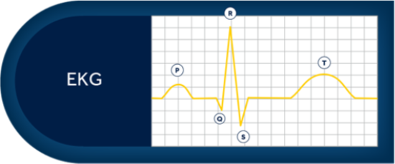
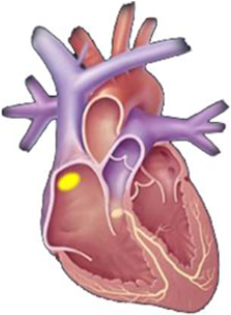
3
ELECTRICAL CONDUCTION AND THE EKG
IMPULSE FORMATION IN SA NODE
The cardiac cycle normally begins with initiation of the impulse at the sinoatrial, or SA node.
Click numbers below to view each step
1
2
3
4
5
6
7

Slide 48
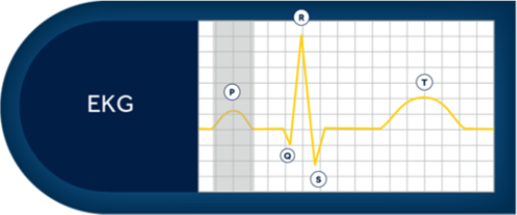
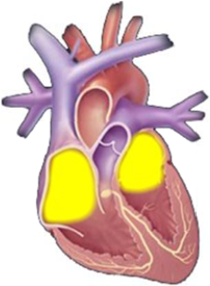
3
ELECTRICAL CONDUCTION AND THE EKG
ATRIAL DEPOLARIZATION
After the SA node fires, the resulting depolarization wave passes through the right and left atria, stimulating atrial contraction and producing the P-wave on the surface ECG.
Click numbers below to view each step
1
2
3
4
5
6
7

Slide 49
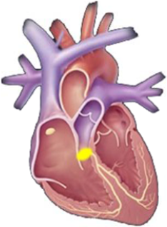
3
ELECTRICAL CONDUCTION AND THE EKG
DELAY AT AV NODE
The impulse proceeds to the atrioventricular (AV) node. The AV node slows the impulse conduction, allowing time for the atria to contract and blood to be pumped from the atria to the ventricles prior to ventricular contraction. Conduction time through the AV node accounts for most of the duration of the PR interval.
Click numbers below to view each step
1
2
3
4
5
6
7

Slide 50
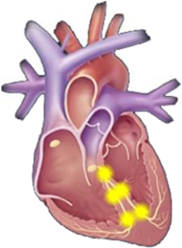
3
ELECTRICAL CONDUCTION AND THE EKG
CONDUCTION THROUGH BUNDLE BRANCHES
The impulse passes through the bundle of His and proceeds through the left and right bundle branches.
Click numbers below to view each step
1
2
3
4
5
6
7

Slide 51
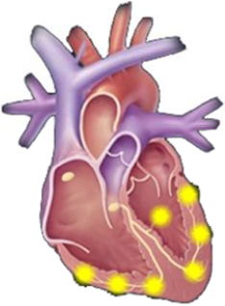
3
ELECTRICAL CONDUCTION AND THE EKG
CONDUCTION TROUGH PURKINJE FIBERS
After leaving the left and right bundle branches, the impulse passes through the Purkinje fibers, which are interlacing fibers of modified cardiac muscle. On the ECG, this is represented as the Q wave.
Click numbers below to view each step
1
2
3
4
5
6
7

Slide 52
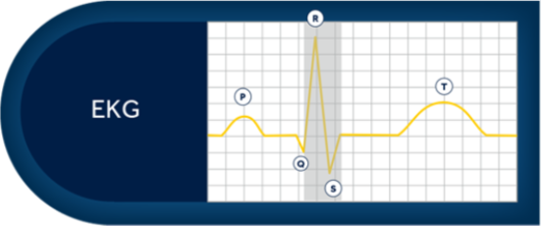
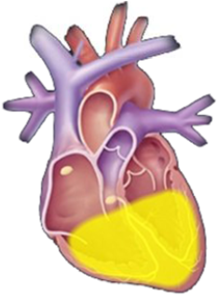
3
ELECTRICAL CONDUCTION AND THE EKG
VENTRICULAR DEPOLARIZATION
The impulse passes quickly through the bundle of His, the left and right bundle branches, and the Purkinje fibers, leading to depolarization and contraction of the ventricles. The QRS complex on the ECG represents the depolarization of the ventricular muscle mass.
Click numbers below to view each step
1
2
3
4
5
6
7

Slide 53
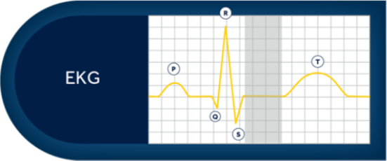
3
ELECTRICAL CONDUCTION AND THE EKG
PLATEAU PHASE OF REPOLARIZATION
Following the QRS complex, the ECG depicts a Plateau Phase, which lasts up to several hundred milliseconds.
Click numbers below to view each step
1
2
3
4
5
6
7

Slide 54
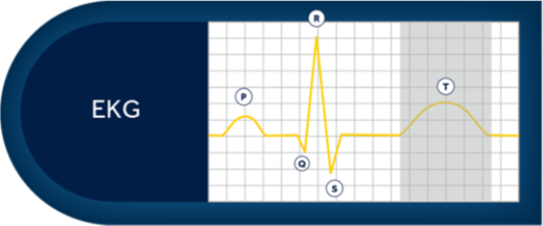
3
ELECTRICAL CONDUCTION AND THE EKG
FINAL RAPID (PHASE 3) REPOLARIZATION
Repolarization of the ventricles generates a current in the body and produces the T-wave on the surface electrogram. This takes place slowly, thus generating a wide wave.
Click numbers below to view each step
1
2
3
4
5
6
7

Slide 55
Put these steps of conduction the electrical impulse follows in order below.
DRAG AND DROP SEQUENCE
Drag the steps below to their correct order In the sequence.
Depolarization of the left and right atrium
Conduction at the bundle branches
Conduction through the Purkinje fibers
The mechanical contraction of the ventricle, or systole
Delay at the AV node
The mechanical relaxation of the ventricle, or diastole
Impulse formation at the SA node
1
2
3
4
5
6
7

Slide 56
Put these steps of conduction the electrical impulse follows in order below.
DRAG AND DROP SEQUENCE
Drag the steps below to their correct order In the sequence.
Impulse formation at the SA node
Depolarization of the left and right atrium
Delay at the AV node
Conduction at the bundle branches
Conduction through the Purkinje fibers
The mechanical contraction of the ventricle, or systole
The mechanical relaxation of the ventricle, or diastole
1
2
3
4
5
6
7

Slide 57
3
KEY POINTS
FOUR KEY POINTS
1
2
3
4
The heart is a four-chambered muscular organ, responsible for the vital transport of blood, oxygen, nutrients, and byproducts to and from the tissues.
The right atrium of the heart collects deoxygenated blood from the superior and inferior vena cava and coronary sinus.
Action potential is the term used to describe specifically how the energy within each cell is generated and used, ultimately causing the heart to contract.
The conduction system is a system of specialized cardiac tissue that controls the heart’s activity (speed and rhythm of contractions) using two main properties:
Automaticity (ability of conduction fibers to spontaneously depolarize)
Conductivity (ability of cardiac cells to rapidly conduct the electrical impulse)

Slide 58
INTRODUCTION
01
Cardiac anatomical structures
02
Cardiac electrical conduction
03
Electrical conduction and the ECG
SUMMARY

Slide 59
Summary
In this module, you learned about the anatomical structures of the heart and their functions. You also learned how electrical impulses travel through the heart, the mechanical effect of this and why the heart contracts.
You should now be able to:
Identify the names, locations, and functions of the main cardiac anatomical structures
Explain how an electrical impulse travels through the heart, and explain what happens mechanically as the electrical impulse moves
Explain what causes the heart to contract by describing automaticity, the action potential cycle of a cardiac cell, the role of the Sinus Node, and the heart’s natural back-up mechanisms

Slide 60
Which chamber of the heart receives oxygenated blood from the lungs via the pulmonary veins?
Right Atrium
Left Atrium
Right Ventricle
Left Ventricle

Slide 61
Which chamber of the heart receives oxygenated blood from the lungs via the pulmonary veins?
Right Atrium
Left Atrium
Right Ventricle
Left Ventricle

Slide 62
During which phase of the cardiac action potential is there an outflow of potassium ions that begins rapid repolarization?
Phase 0
Phase 1
Phase 2
Phase 3

Slide 63
During which phase of the cardiac action potential is there an outflow of potassium ions that begins rapid repolarization?
Phase 0
Phase 1
Phase 2
Phase 3

Slide 64
Which of the following are considered semilunar valves?
Mitral Valve and Aortic Valve
Aortic Valve and Tricuspid Valve
Tricuspid Valve and Pulmonary Valve
Pulmonary Valve and Aortic Valve

Slide 65
Which of the following are considered semilunar valves?
Mitral Valve and Aortic Valve
Aortic Valve and Tricuspid Valve
Tricuspid Valve and Pulmonary Valve
Pulmonary Valve and Aortic Valve

Slide 66
Which structure in the heart’s electrical system can be considered the heart’s ‘back-up’ pacemaker, delivering impulses to the ventricles at rates between 40 to 60 beats per minute?
His Bundle
AV Node
SA Node
The Purkinje Network

Slide 67
Which structure in the heart’s electrical system can be considered the heart’s ‘back-up’ pacemaker, delivering impulses to the ventricles at rates between 40 to 60 beats per minute?
His Bundle
AV Node
SA Node
The Purkinje Network

Slide 68
Which of the following terms describes the mechanical contraction of the ventricle?
Automaticity
Systole
Conductivity
Diastole

Slide 69
Which of the following terms describes the mechanical contraction of the ventricle?
Automaticity
Systole
Conductivity
Diastole

